Slide 1
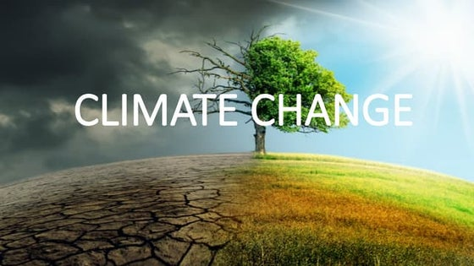
A Global Crisis

Slide 2
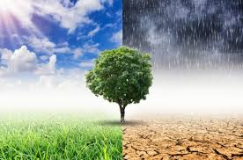
What is Climate Change?
Long-term shifts in temperatures and weather patterns
Mainly caused by human activities (burning fossil fuels)

Slide 3
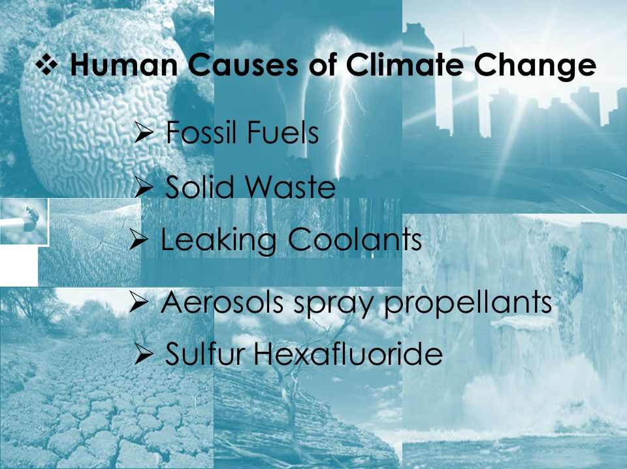

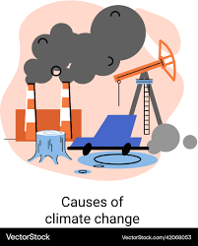

Slide 4
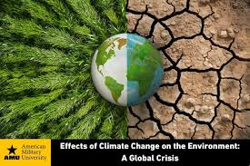
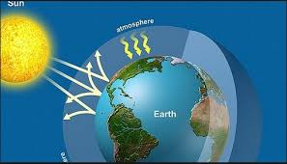
Effects on the Planet
Rising global temperatures 🌡️
Melting ice caps & rising sea levels 🌊
Extreme weather events (storms, droughts)

Slide 5
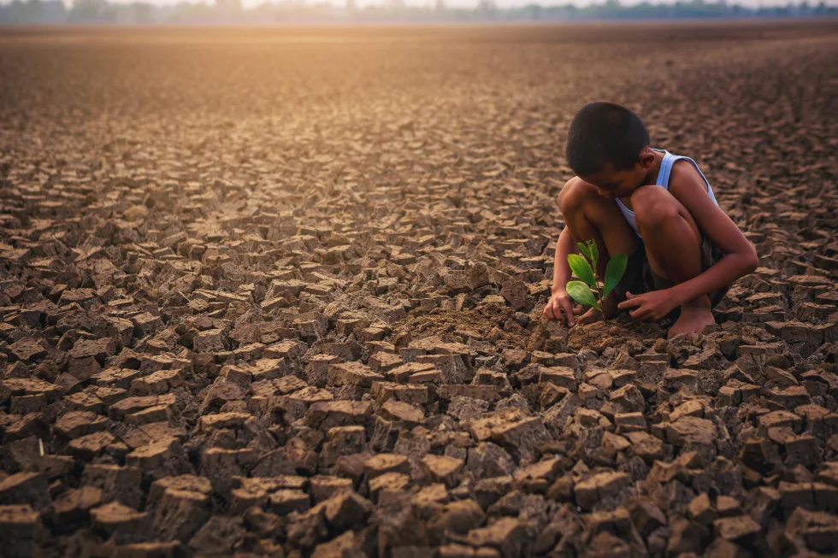
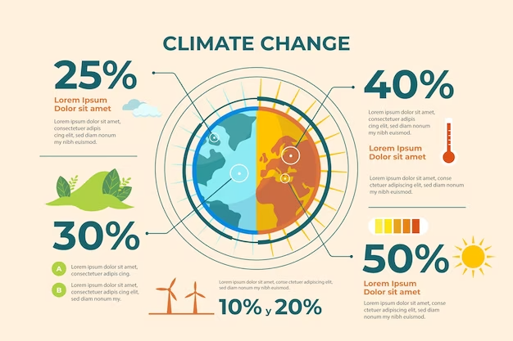
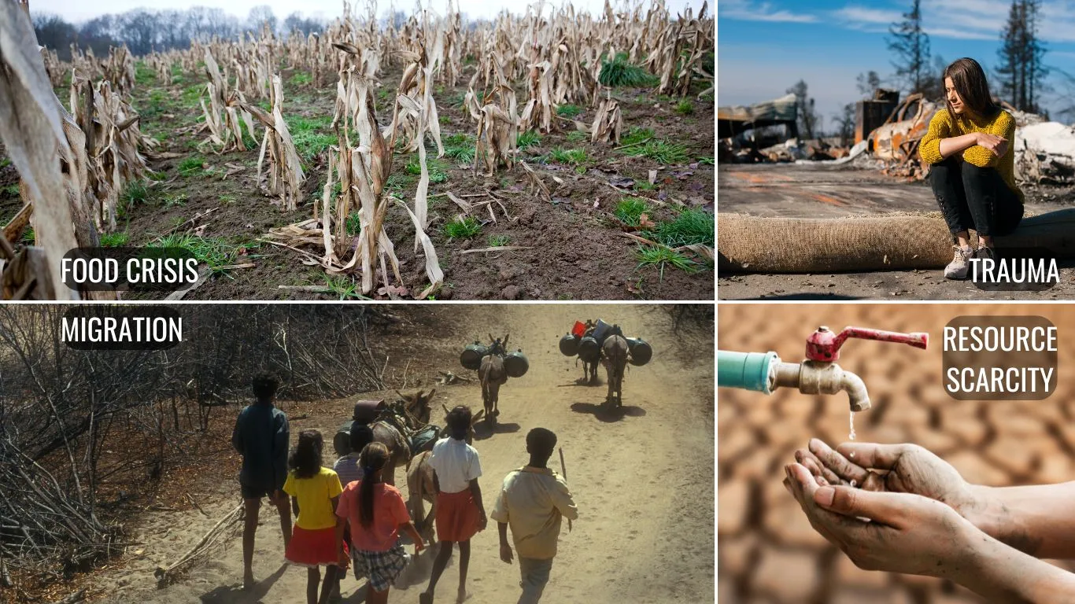
Impacts on Humans
Threats to food and water security
Health risks from heatwaves & disease
Economic losses & climate migration

Slide 6

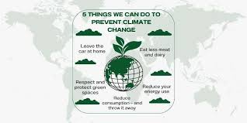
What Can We Do?
Switch to renewable energy (solar, wind)
Reduce, reuse, recycle ♻️
Protect forests and plant trees
Support climate-friendly policies

Slide 7


Global Action
Paris Agreement 🌐
IPCC reports
Youth movements & climate activism

Slide 8

Climate change is real and urgent
Everyone can contribute to the solution
Act now for a sustainable future 🌱

Slide 9

Thank you

